Slide 1

Chapter 7
Defining Your Own Classes
Part 2
Animated Version

Slide 2
Objectives
After you have read and studied this chapter, you should be able to
  Describe how objects are returned from methods
  Describe how the reserved word this is used
  Define overloaded methods and constructors
  Define class methods and variables
  Describe how the arguments are passed to the parameters using the pass-by-value scheme
  Document classes with javadoc comments
  Organize classes into a package
Notes:
A class is instantiable if we can create instances of it. For example, the JFrame class is instantiable. A class is noninstantiable if we cannot create its instances. The Math class is one example of noninstantiable classes. The main classes we have been writing are all noninstantiable. We will learn how to define instantiable classes in this lesson. A constructor is a special method that is used to initialize an instance of a class when it is first created.

Slide 3
Returning an Object from a Method
As we can return a primitive data value from a method, we can return an object from a method also.
We return an object from a method, we are actually returning a reference (or an address) of an object.
  This means we are not returning a copy of an object, but only the reference of this object
Notes:
We already know how to return an object from a method, because we have been returning a string from a method and a string is an object (an instance of the String class). However, String objects are treated much like primitive data. We will explore a little deeper into this topic.

Slide 4
Sample Object-Returning Method
Here's a sample method that returns an object:
Return type indicates the class of an object we're returning from the method.
public Fraction simplify( ) {
Fraction simp;
int num = getNumberator();
int denom = getDenominator();
int gcd = gcd(num, denom);
simp = new Fraction(num/gcd, denom/gcd);
return simp;
}
Return an instance of the Fraction class

Slide 5
A Sample Call to simplify
public Fraction simplify( ) {
int num = getNumerator();
int denom = getDenominator();
int gcd = gcd(num, denom);
Fraction simp = new
Fraction(num/gcd, denom/gcd);
return simp;
}
f1 = new Fraction(24, 26);
f2 = f1.simplify();
f1
simp
f2
: Fraction
: Fraction
numerator
numerator
24
2
denominator
denominator
36
3

Slide 6
A Sample Call to simplify (cont'd)
public Fraction simplify( ) {
int num = getNumerator();
int denom = getDenominator();
int gcd = gcd(num, denom);
Fraction simp = new
Fraction(num/gcd, denom/gcd);
return simp;
}
f1 = new Fraction(24, 26);
f2 = f1.simplify();
f1
simp
f2
: Fraction
: Fraction
: Fraction
numerator
numerator
numerator
The value of simp, which is a reference, is returned and assigned to f2.
24
2
2
denominator
denominator
denominator
36
3
3

Slide 7
Reserved Word this
The reserved word this is called a self-referencing pointer because it refers to an object from the object's method.
: Object
this
The reserved word this can be used in three different ways. We will see all three uses in this chapter.

Slide 8
The Use of this in the add Method
public Fraction add(Fraction frac) {
int a, b, c, d;
Fraction sum;
a = this.getNumerator(); //get the receiving
b = this.getDenominator(); //object's num and denom
c = frac.getNumerator(); //get frac's num
d = frac.getDenominator(); //and denom
sum = new Fraction(a*d + b*c, b*d);
return sum;
}
Notes:
The use of the reserved word this is option in this context. Calling a method of a class or accessing a data member of the class can be achieved without the reserved word this. Consider, for example,
class One {
public int m1( ) {
return 10;
}
public void m2( ) {
int num;
num = m1(); ← this is equivalent to num = this.m1();
}
}

Slide 9
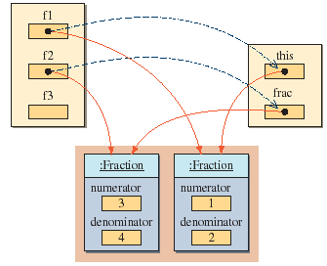
f3 = f1.add(f2)
Because f1 is the receiving object (we're calling f1's method), so the reserved word this is referring to f1.

Slide 10
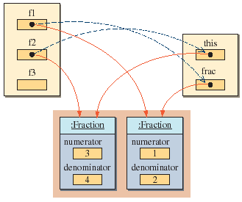
f3 = f2.add(f1)
This time, we're calling f2's method, so the reserved word this is referring to f2.

Slide 11
Using this to Refer to Data Members
In the previous example, we showed the use of this to call a method of a receiving object.
It can be used to refer to a data member as well.
class Person {
int age;
public void setAge(int val) {
this.age = val;
}
. . .
}

Slide 12
Overloaded Methods
Methods can share the same name as long as
  they have a different number of parameters (Rule 1) or
  their parameters are of different data types when the number of parameters is the same (Rule 2)
public void myMethod(int x, int y) { ... }
public void myMethod(int x) { ... }
Rule 1
public void myMethod(double x) { ... }
public void myMethod(int x) { ... }
Rule 2
Notes:
Notice that the difference in the return type alone is not enough to overload the methods. For example, the following declaration is invalid
public double convert(int num) { . . . }
public float convert(int num) { . . . }

Slide 13
Overloaded Constructor
The same rules apply for overloaded constructors
  this is how we can define more than one constructor to a class
public Person( ) { ... }
public Person(int age) { ... }
Rule 1
public Pet(int age) { ... }
public Pet(String name) { ... }
Rule 2
Notes:
Notice that the difference in the return type alone is not enough to overload the methods. For example, the following declaration is invalid
public double convert(int num) { . . . }
public float convert(int num) { . . . }

Slide 14
Constructors and this
public Fraction( ) {
//creates 0/1
this(0, 1);
}
public Fraction(int number) {
//creates number/1
this(number, 1);
}
public Fraction(Fraction frac) {
//copy constructor
this(frac.getNumerator(),
frac.getDenominator());
}
public Fraction(int num, int denom) {
setNumerator(num);
setDenominator(denom);
}
To call a constructor from another constructor of the same class, we use the reserved word this.
Notes:
Without using the reserved word this, we need to define the four constructors as follows (it forces us to repeat the same code):
public Fraction( ) { //creates 0/1
setNumerator(0);
setDenominator(1);
}
public Fraction(int number) { //creates number/1
setNumerator(number);
setDenominator(1);
}
public Fraction(Fraction frac) { //copy constructor
setNumerator(frac.getNumerator());
setDenominator(frac.getDenominator());
}
public Fraction(int num, int denom) {
setNumerator(num);
setDenominator(denom);
}

Slide 15
Class Methods
We use the reserved word static to define a class method.
public static int gcd(int m, int n) {
//the code implementing the Euclidean algorithm
}
public static Fraction min(Fraction f1, Fraction f2) {
//convert to decimals and then compare
}

Slide 16
Call-by-Value Parameter Passing
When a method is called,
  the value of the argument is passed to the matching parameter, and
  separate memory space is allocated to store this value.
This way of passing the value of arguments is called a pass-by-value or call-by-value scheme.
Since separate memory space is allocated for each parameter during the execution of the method,
  the parameter is local to the method, and therefore
  changes made to the parameter will not affect the value of the corresponding argument.

Slide 17
Call-by-Value Example
class Tester {
  public void myMethod(int one, double two ) {
  one = 25;
    two = 35.4;
}
}
Tester tester;
int x, y;
tester = new Tester();
x = 10;
y = 20;
tester.myMethod(x, y);
System.out.println(x + " " + y);
10 20
produces

Slide 18
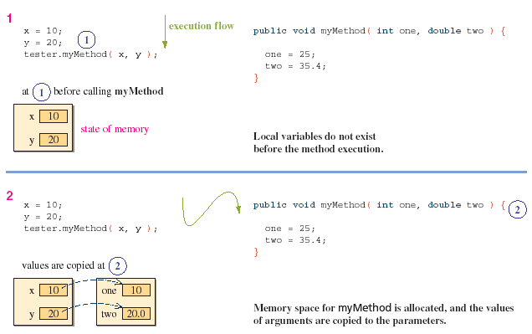
Memory Allocation for Parameters

Slide 19
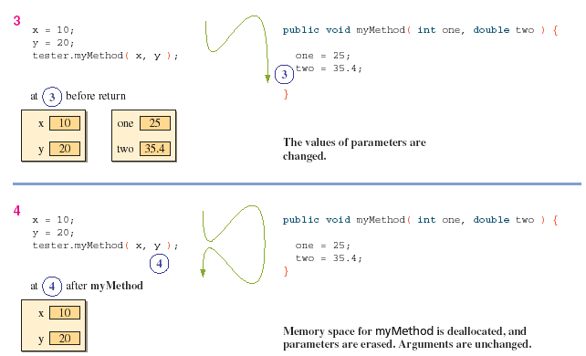
Memory Allocation for Parameters (cont'd)

Slide 20

Parameter Passing: Key Points
1. Arguments are passed to a method by using the pass-by- value scheme.
2. Arguments are matched to the parameters from left to right.The data type of an argument must be assignment-compatible with the data type of the matching parameter.
3. The number of arguments in the method call must match the number of parameters in the method definition.
4. Parameters and arguments do not have to have the same name.
5. Local copies, which are distinct from arguments,are created even if the parameters and arguments share the same name.
6. Parameters are input to a method, and they are local to the method.Changes made to the parameters will not affect the value of corresponding arguments.
Notes:
In Java it's always pass-by-value even for object type
Explain this with object example before moving to next slide
Demo: SwapTest

Slide 21
Main Point
Java method calls are in every case call by value (and never call by reference). Even though an object reference can be passed, only a copy of such a variable is ever passed to a method (in other words, call by value). Call by value is resembles the incorruptible quality of pure consciousness – "fire cannot burn it, nor water wet it".
Notes:
- the variable that stores the reference cannot be made to point to a different reference within the method

Slide 22
Organizing Classes into a Package
For a class A to use class B, their bytecode files must be located in the same directory.
  This is not practical if we want to reuse programmer-defined classes in many different programs
The correct way to reuse programmer-defined classes from many different programs is to place reusable classes in a package.
A package is a Java class library.

Slide 23
Creating a Package
The following steps illustrate the process of creating a package name myutil that includes the Fraction class.
  1. Include the statement
    package myutil;
  as the first statement of the source file for the Fraction class.
  2. The class declaration must include the visibility modifier public as
        public class Fraction {
        ...
        }
  3. Create a folder named myutil, the same name as the package name. In Java, the package must have a one-to-one correspondence with the folder.
  4. Place the modified Fraction class into the myutil folder and compile it.
  5. Modify the CLASSPATH environment variable to include the folder that contains the myutil folder.

Slide 24
Using Javadoc Comments
Many of the programmer-defined classes we design are intended to be used by other programmers.
  It is, therefore, very important to provide meaningful documentation to the client programmers so they can understand how to use our classes correctly.
By adding javadoc comments to the classes we design, we can provide a consistent style of documenting the classes.
Once the javadoc comments are added to a class, we can generate HTML files for documentation by using the javadoc command.

Slide 25
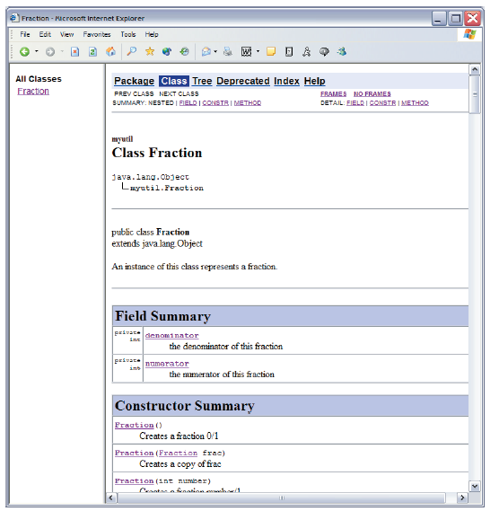
javadoc for Fraction
This is a portion of the HTML documentation for the Fraction class shown in a browser.
This HTML file is produced by processing the javadoc comments in the source file of the Fraction class.

Slide 26
javadoc Tags
The javadoc comments begins with /** and ends with */
Special information such as the authors, parameters, return values, and others are indicated by the @ marker
  @param
  @author
  @return
  etc

Slide 27
Example: javadoc Source
. . .
/**
* Returns the sum of this Fraction
* and the parameter frac. The sum
* returned is NOT simplified.
*
* @param frac the Fraction to add to this
* Fraction
*
* @return the sum of this and frac
*/
public Fraction add(Fraction frac) {
...
}
. . .
this javadoc
will produce
Notes:
In the command prompt window, we used the commands javac and java to compile and run Java programs, respectively. Similarly, to generate javadoc files, we use the javadoc command.
For example, to generate a javadoc file for the Fraction class, we enter
javadoc -private Fraction.java
We specify the -private option because we want to generate the documentation for all types of methods (so far, we have covered two of these—private and public). The private option generates the most complete documentation.

Slide 28
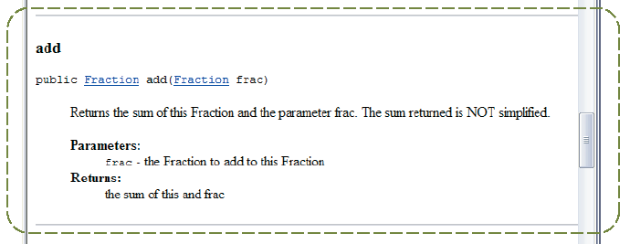
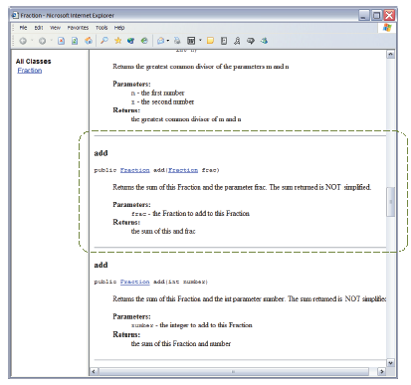
Example: javadoc Output

Slide 29
javadoc Resources
General information on javadoc is located at
  http://java.sun.com/j2se/javadoc
Detailed reference on how to use javadoc on Windows is located at
  http://java.sun.com/j2se/1.5/docs/tooldocs/windows/javadoc.html

